Slide 1
Data and Statistics Review
Biology 364/664
Prof. Ken Field
Acknowledgements:
Slides developed by Mine Çetinkaya-Rundel of OpenIntro.
Translated from LaTeX to Google Slides by Curry Hilton of OpenIntro.
The slides may be copied, edited, and/or shared via the CC BY-SA license.

Slide 2
Classroom survey
A survey was conducted on students in an introductory statistics course. Below are a few of the questions on the survey, and the corresponding variables the data from the responses were stored in:
gender: What is your gender?
intro_extra: What is your gender?
sleep: How many hours do you sleep at night, on average?
bedtime: What time do you usually go to bed?
countries: How many countries have you visited?
dread: On a scale of 1-5, how much do you dread being here?

Slide 3
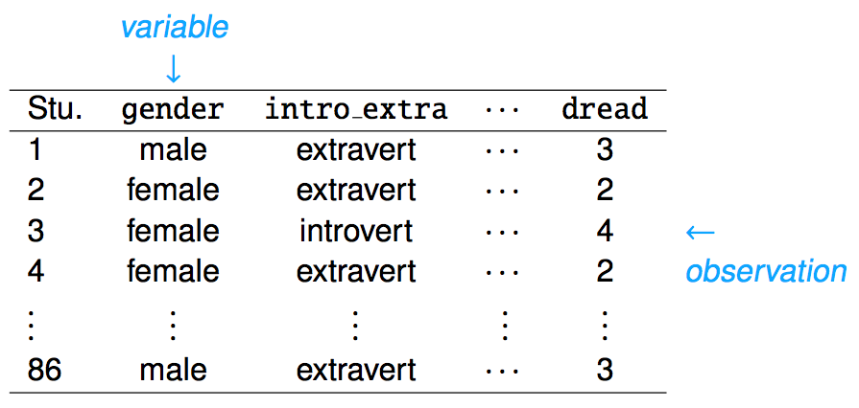
Data Table
Data collected on students in a statistics class on a variety of variables:

Slide 4
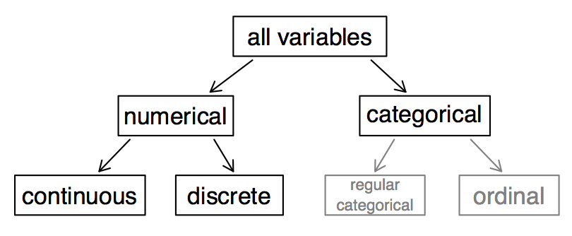
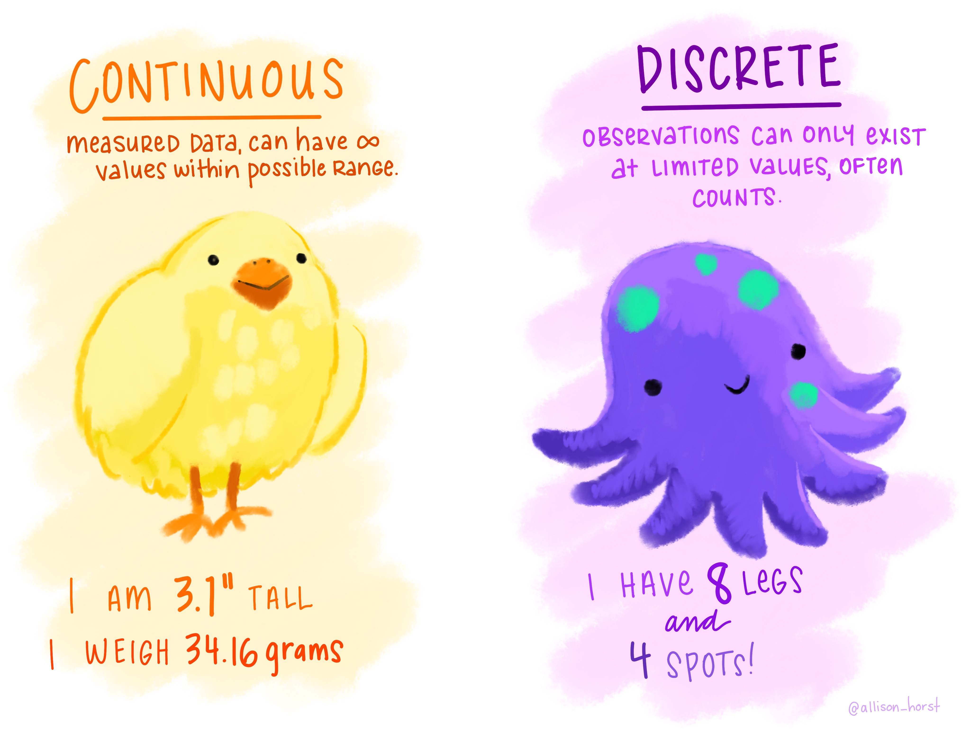
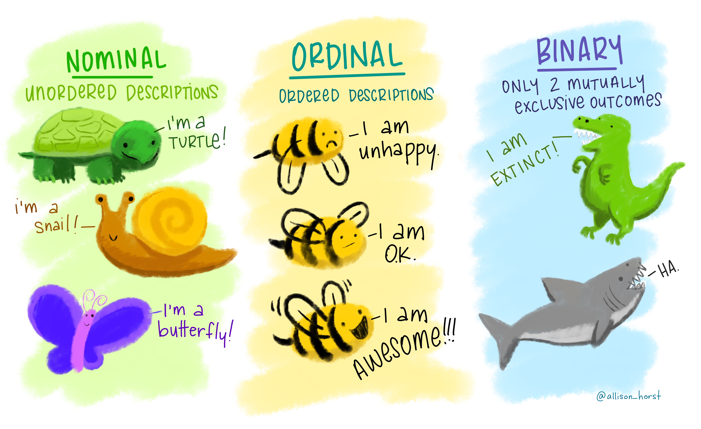
Types of variables
Artwork by @allison_horst

Slide 5
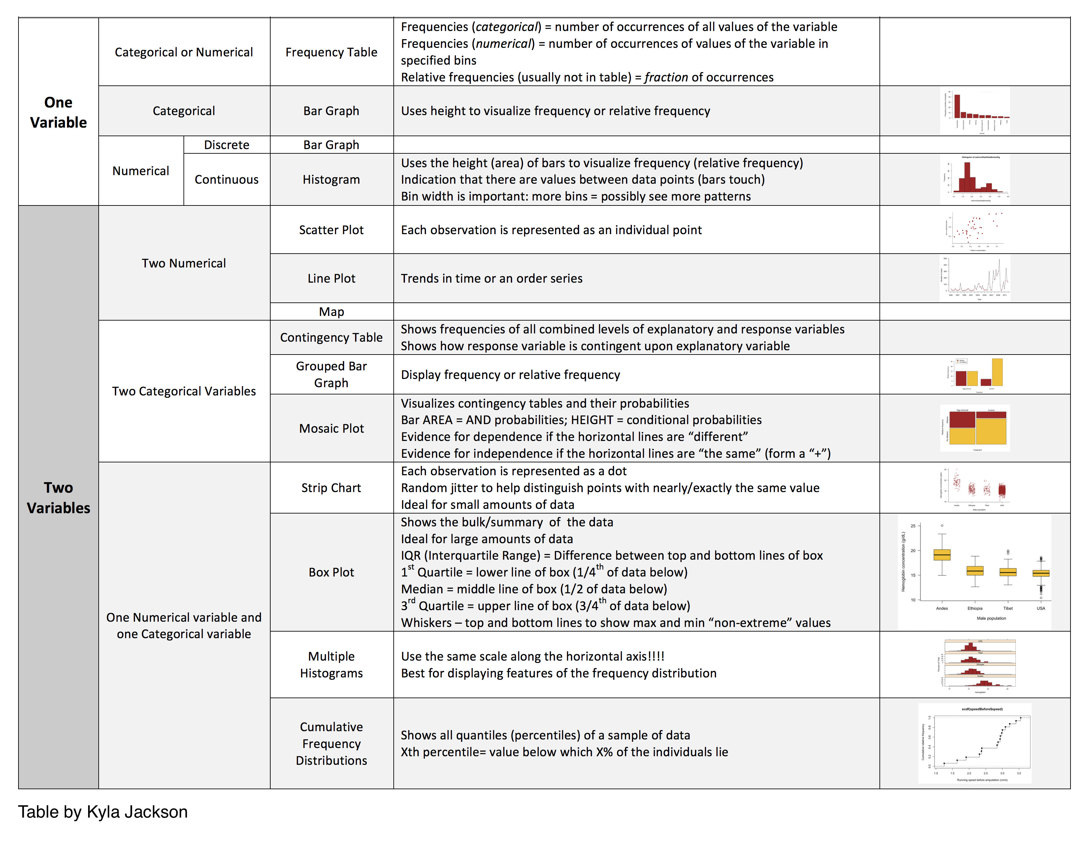
Plot Types

Slide 6
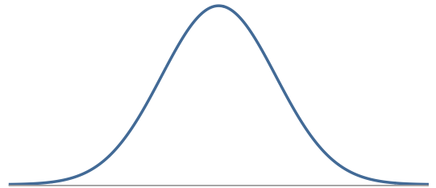
Continuous Variables: Normal Distribution
Unimodal and symmetric, bell shaped curve
Many variables are nearly normal, but none are exactly normal
Denoted as N(µ, σ) → Normal with mean µ and standard deviation σ

Slide 7
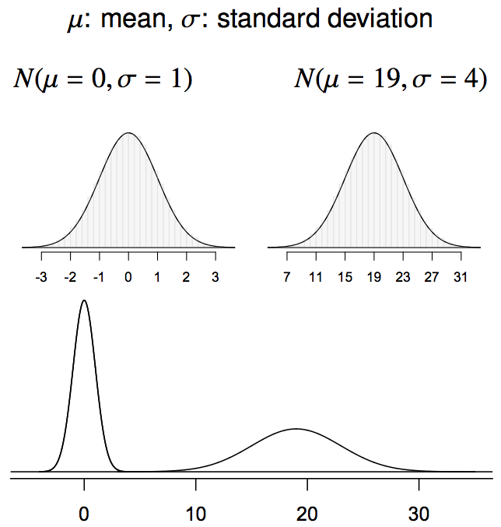
Normal distributions with different parameters

Slide 8
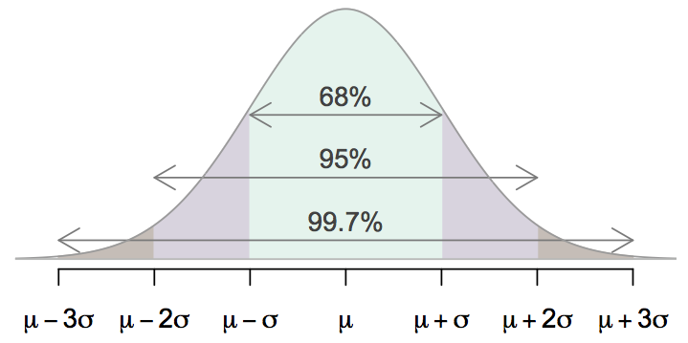
68-95-99.7 Rule
For nearly normally distributed data,
about 68% falls within 1 SD of the mean,
about 95% falls within 2 SD of the mean,
about 99.7% falls within 3 SD of the mean.
It is possible for observations to fall 4, 5, or more standard deviations away from the mean, but these occurrences are very rare if the data are nearly normal.

Slide 9
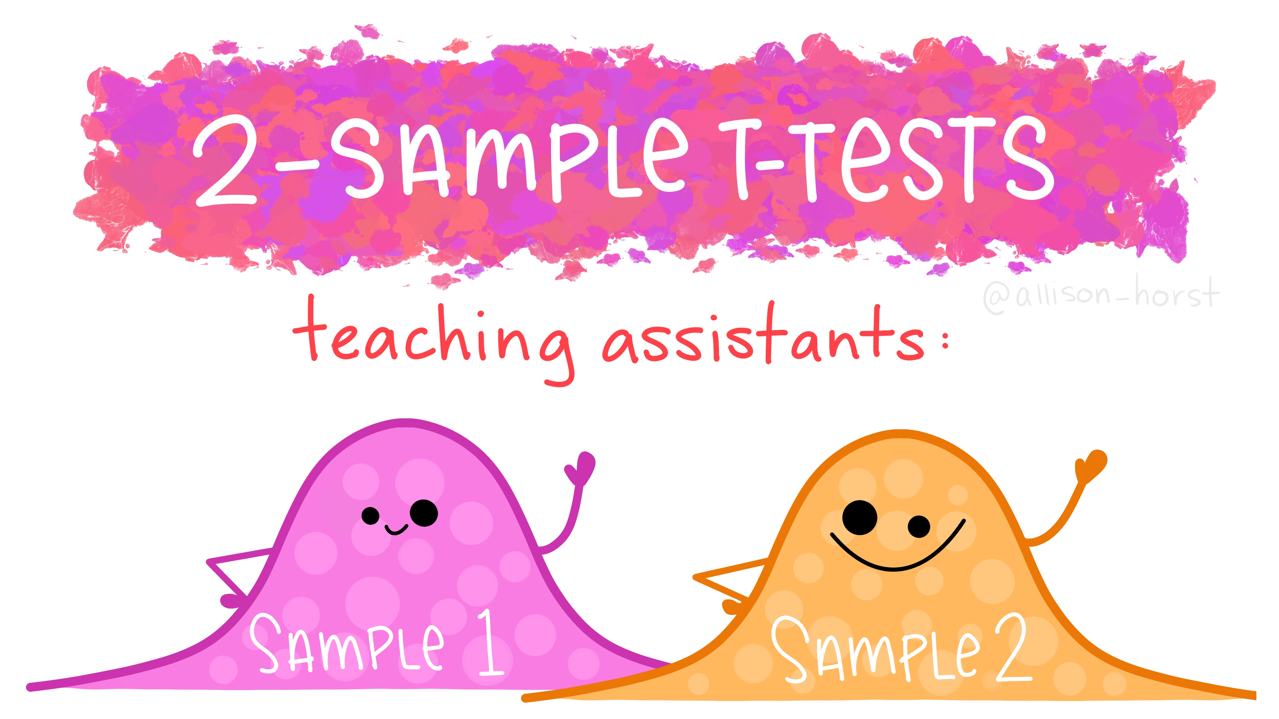
Artwork by @allison_horst

Slide 10
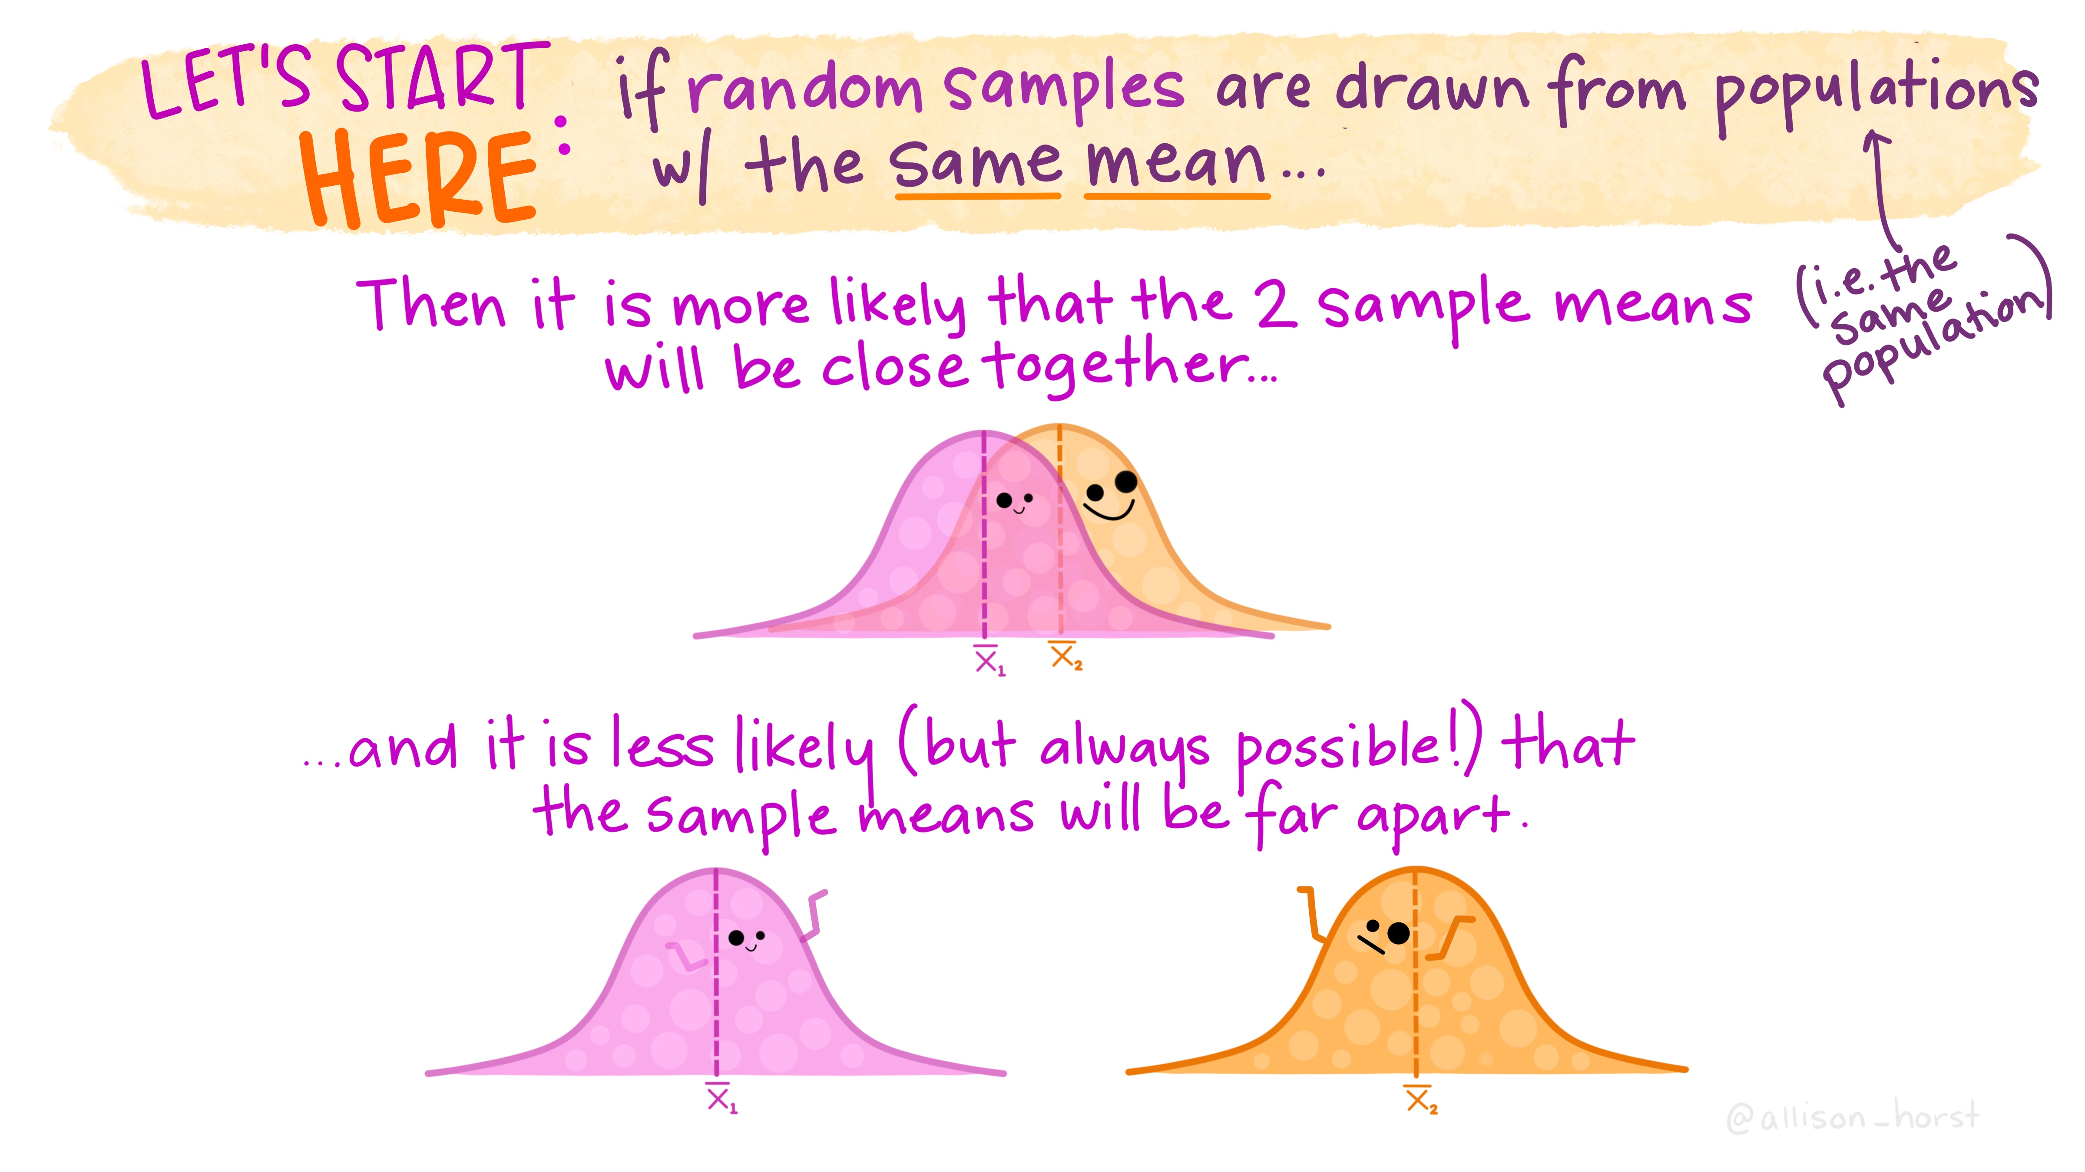
Artwork by @allison_horst

Slide 11
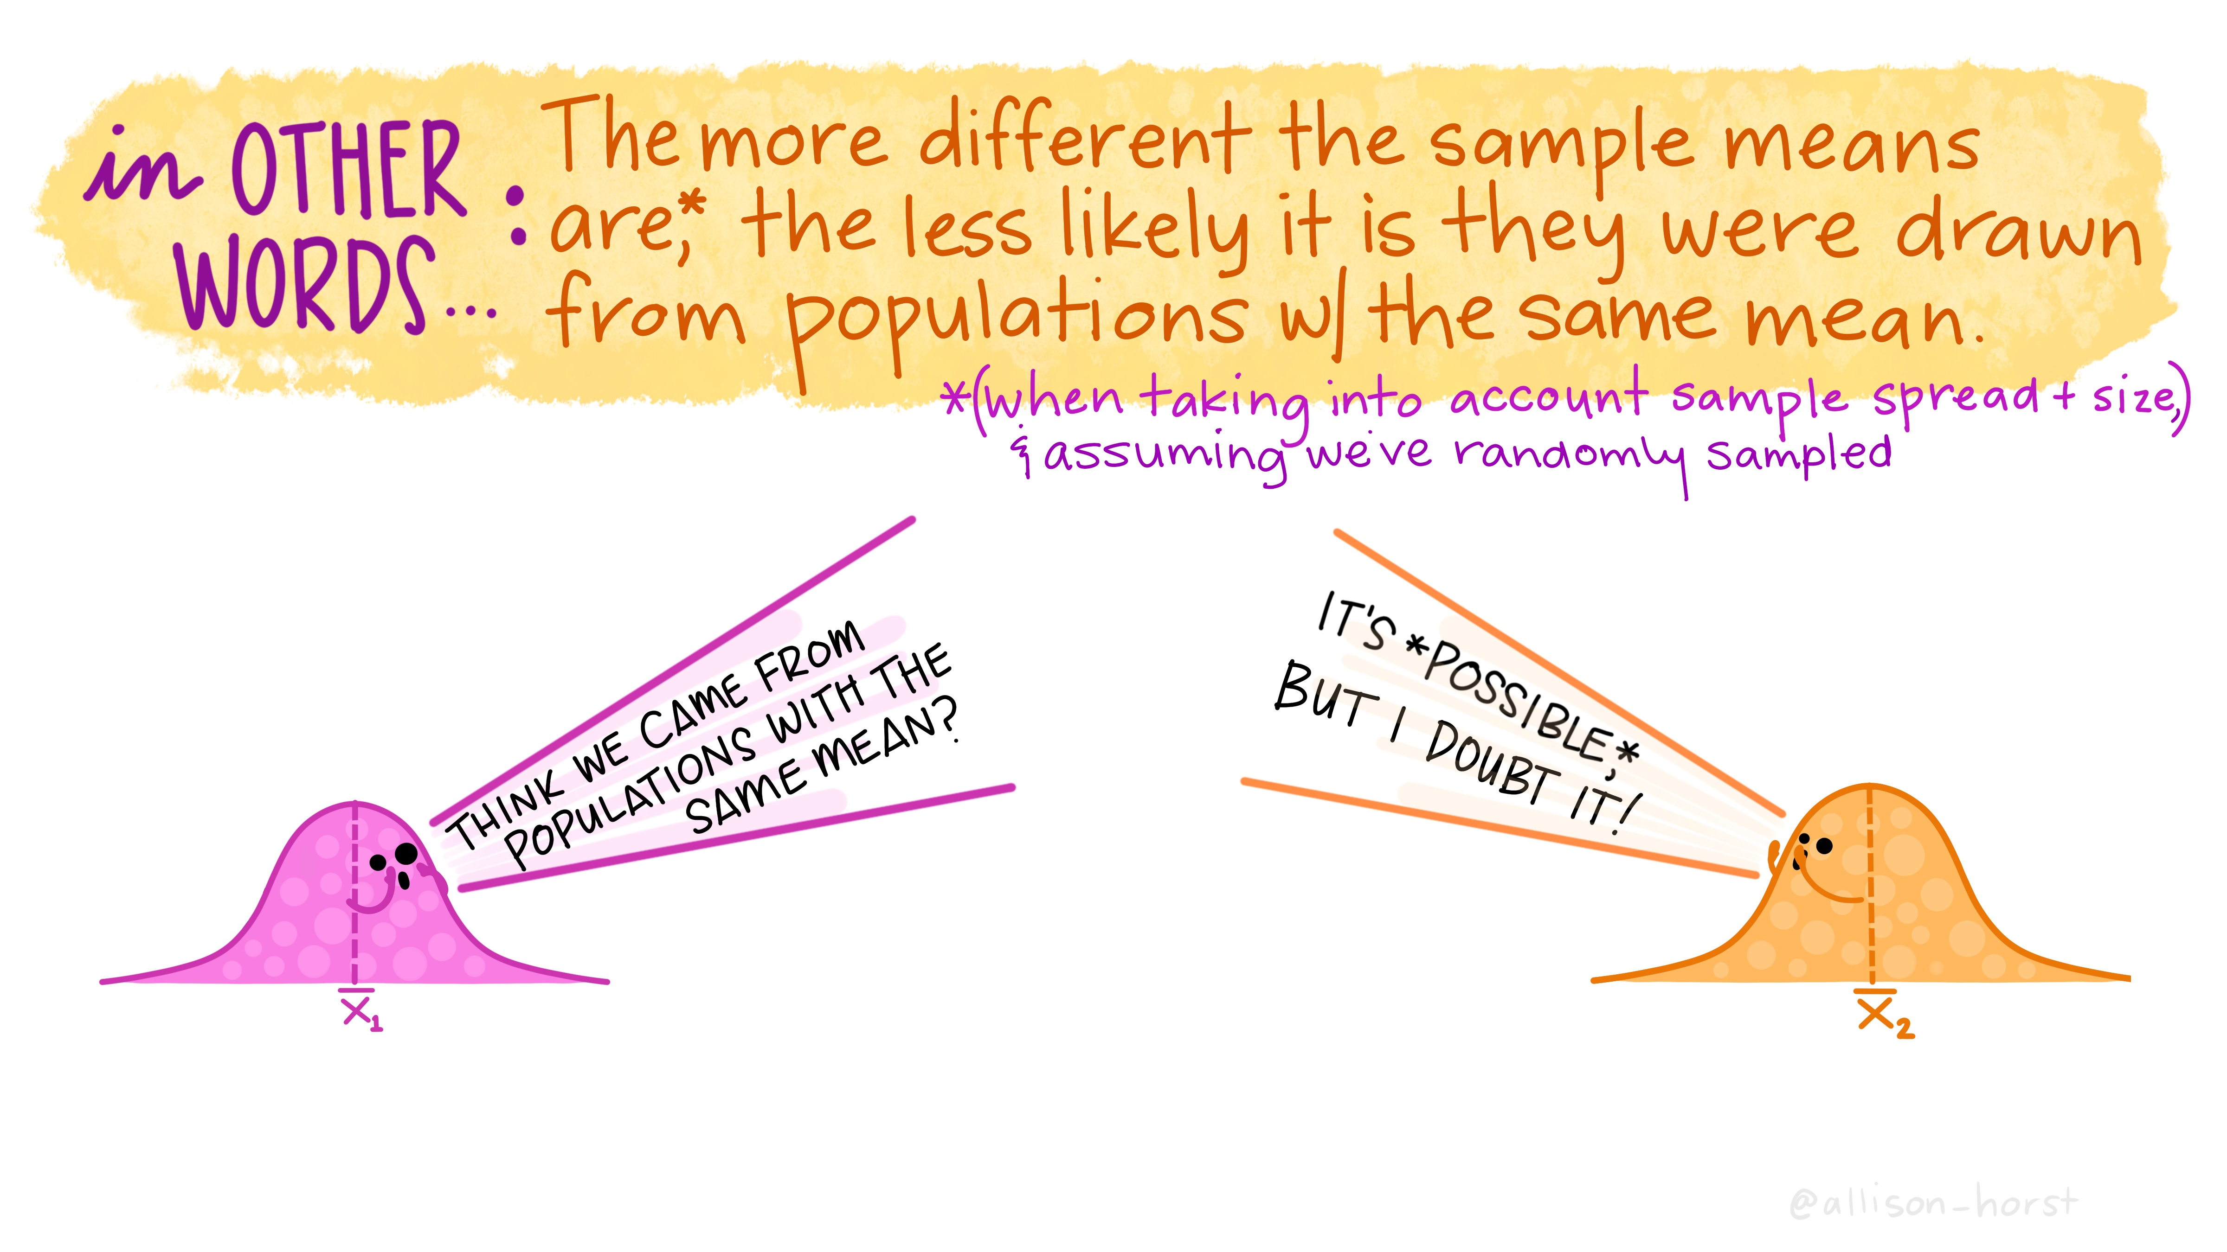
Artwork by @allison_horst

Slide 12
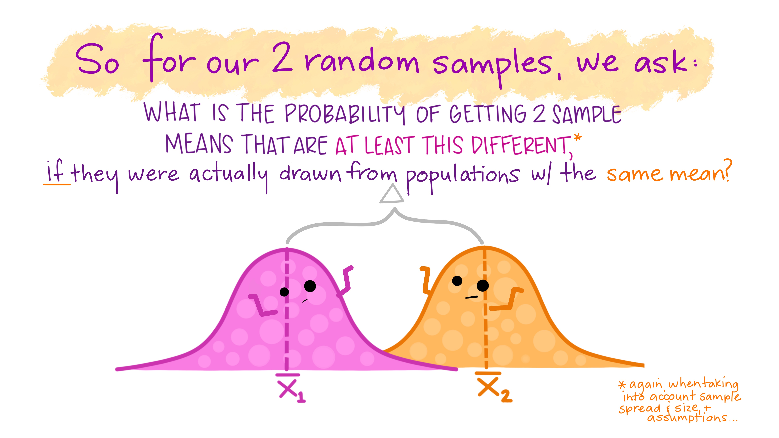
Artwork by @allison_horst

Slide 13
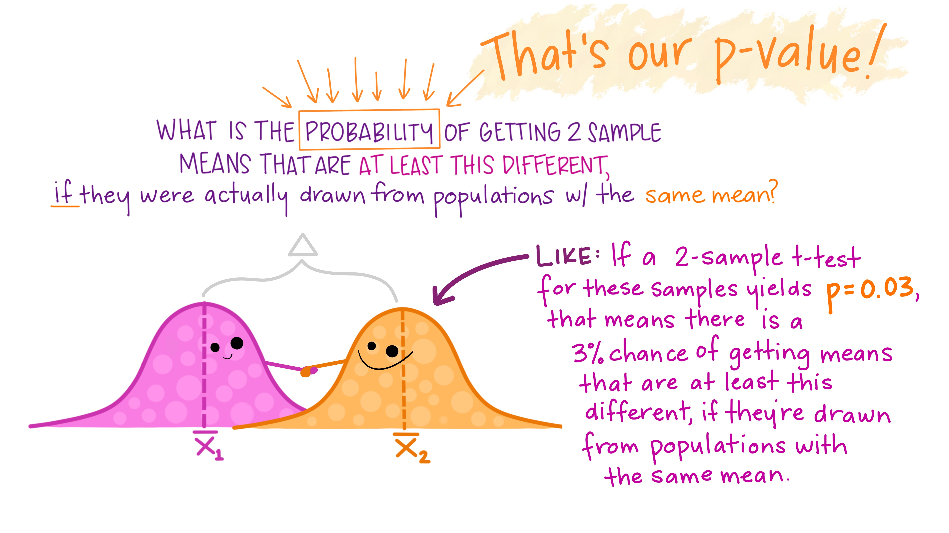
Artwork by @allison_horst

Slide 14
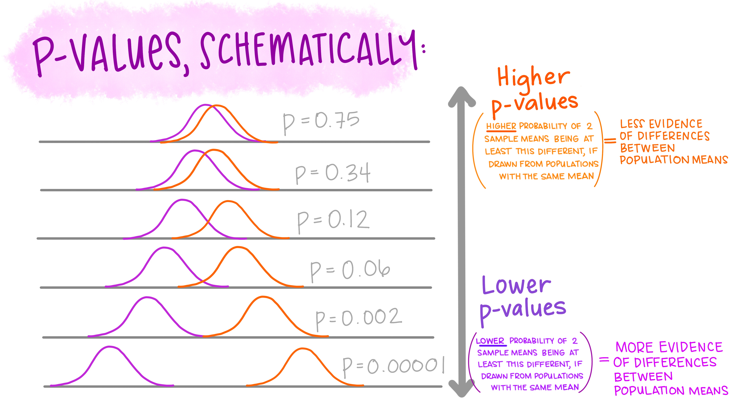
Artwork by @allison_horst

Slide 15
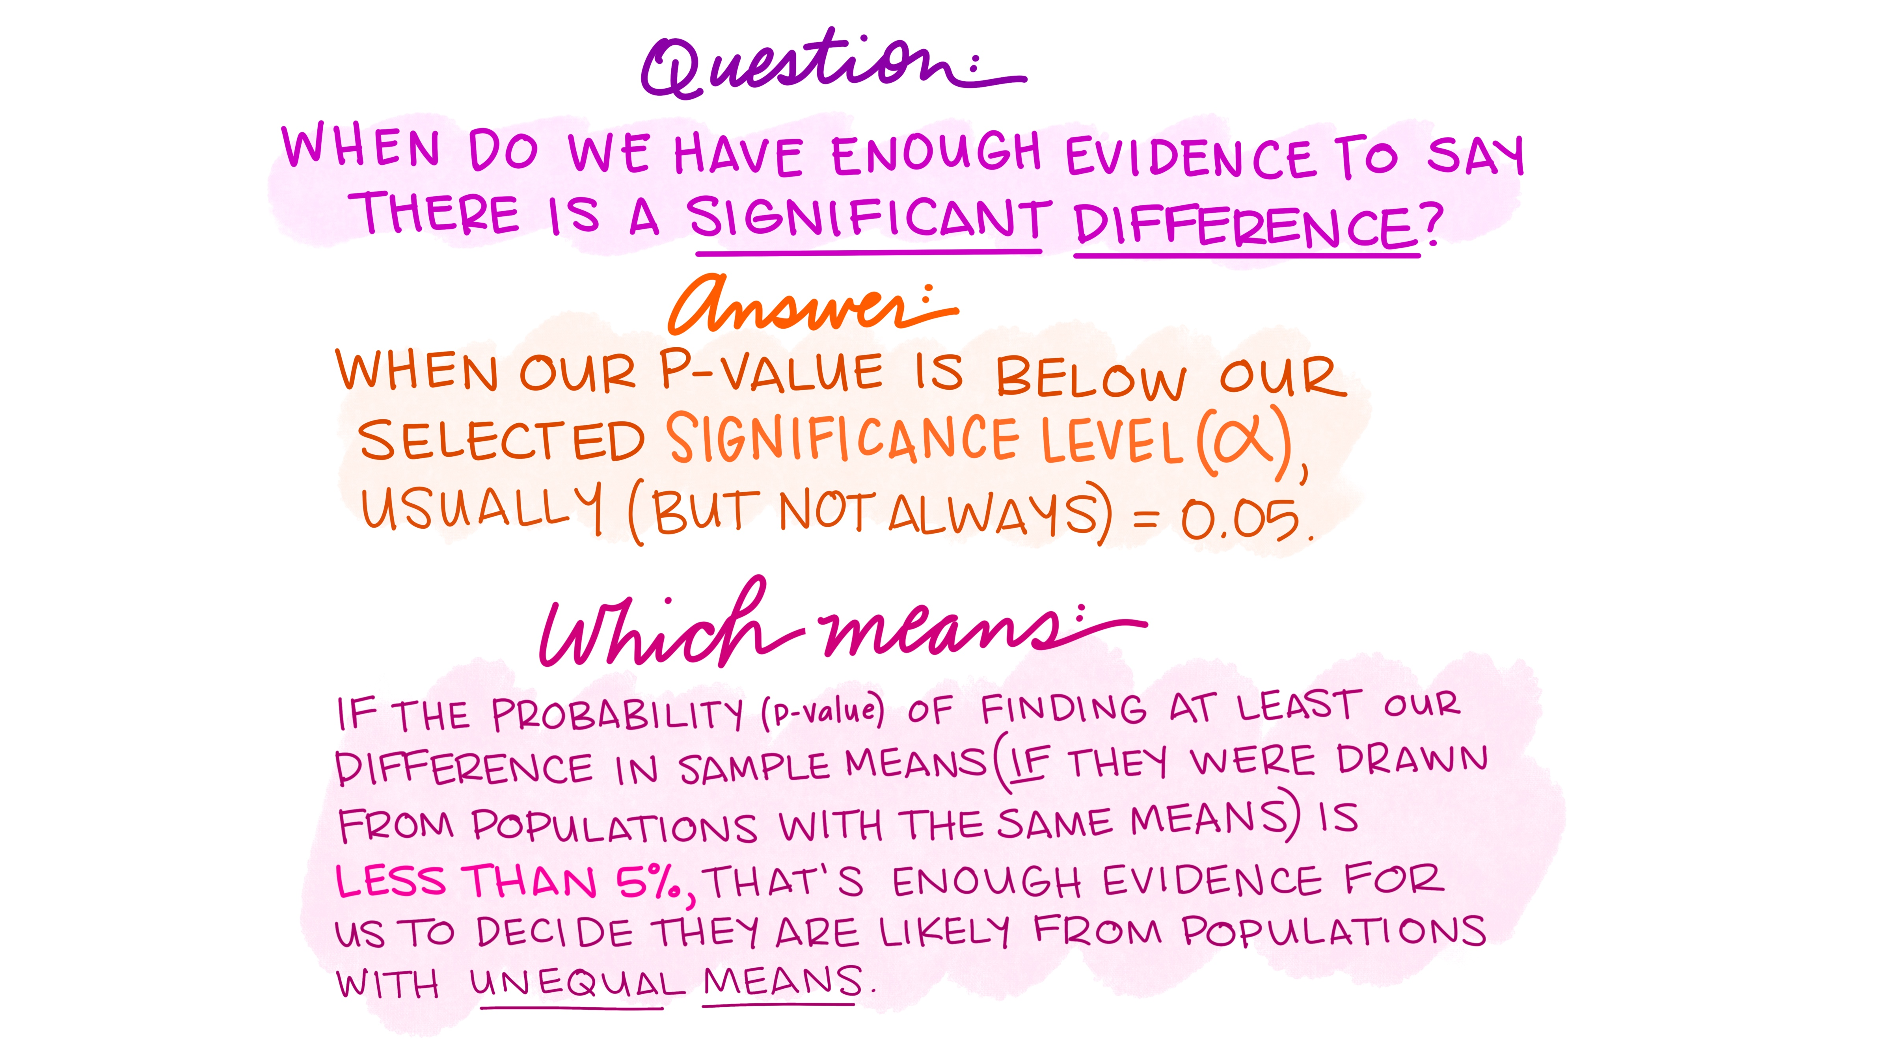
Artwork by @allison_horst

